Slide 1
Detection and Evaluation of Molecular Biomarkers in Ovarian Cancer - BERLINER Study

Slide 2
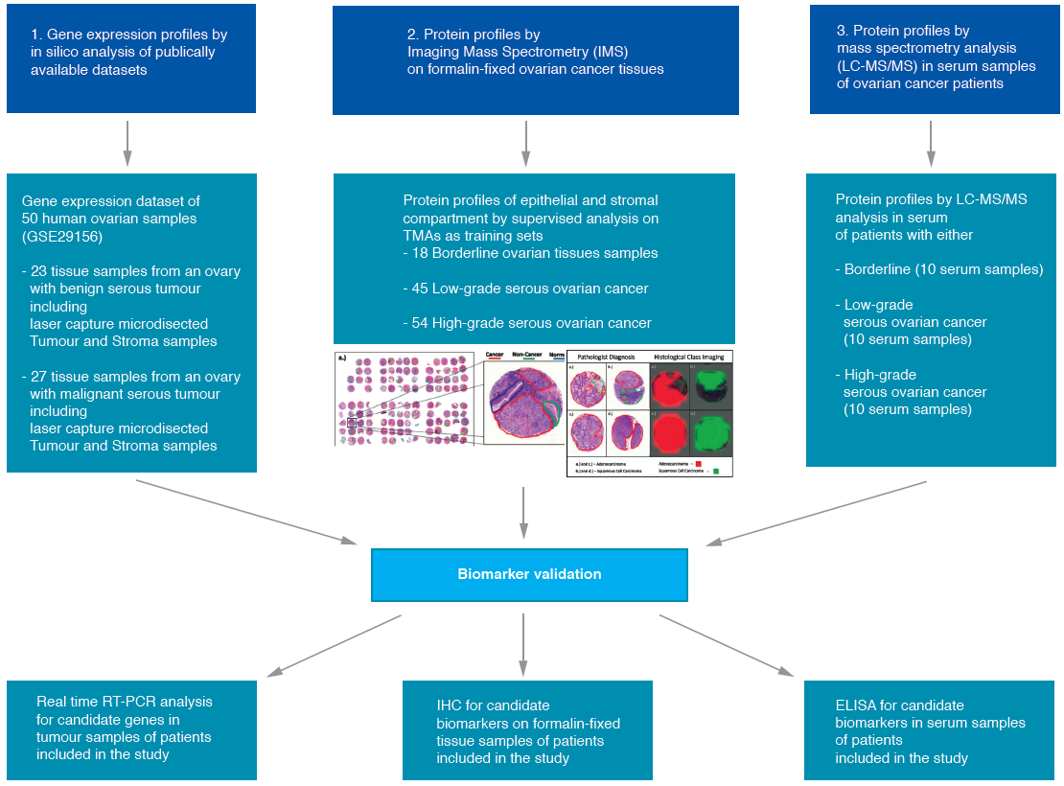

Slide 3
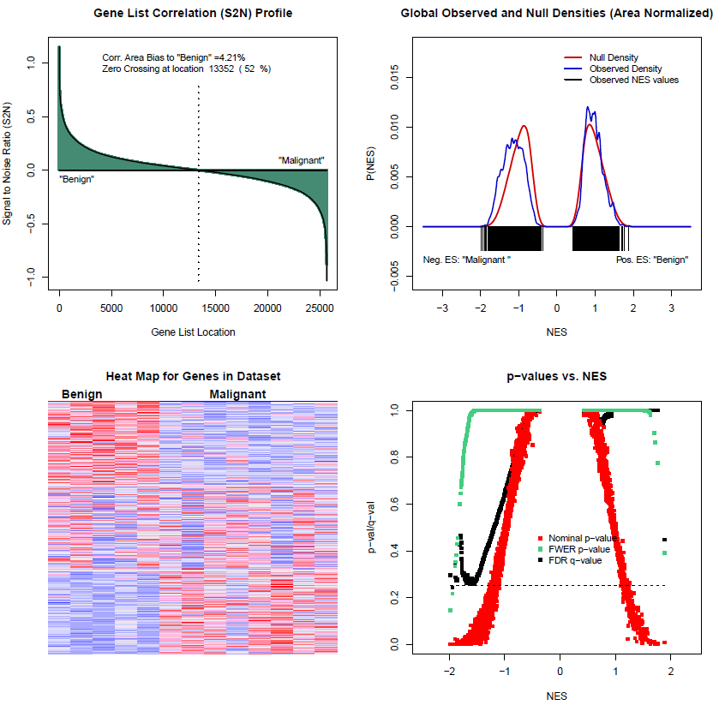
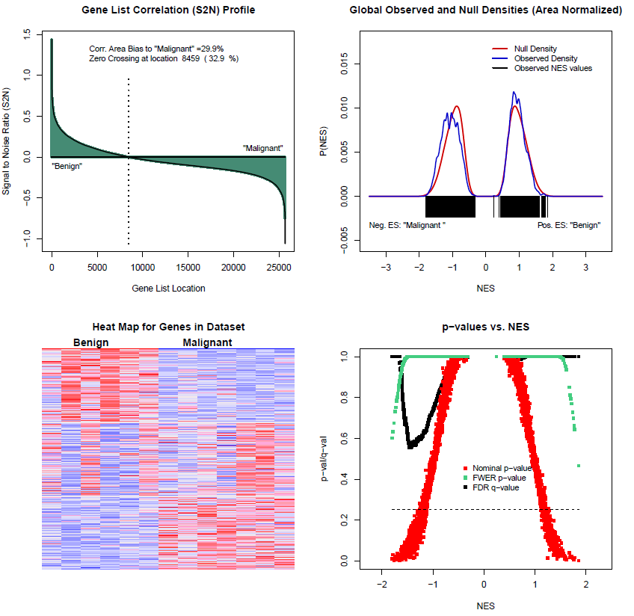
Differentially expressed genes in dataset GSE29156
Malignant versus benign epithelium
Malignant versus benign adjacent stroma

Slide 4
Lists of differentially expressed genes in
dataset GSE29156
1. Malignant versus benign epithelium
Total of 170 differentially expressed genes / 74 of them higher in malignant tumour samples (cut off 2-fold; p < 0.01)
30 genes included in Virtual Secretome Array published by Michael Birrer (Clin. Cancer Res. May 2015)
2. Malignant versus benign adjacent stroma
Total of 193 differentially expressed genes / 59 of them higher in malignant tumour samples (cut off 2-fold; p < 0.01)
30 genes included in Virtual Secretome Array
3. Combined malignant/stroma versus benign/stroma
Total of 831 differentially expressed genes / 268 of them higher in malignant tumour samples (cut off 2-fold; p < 0.01)
122 genes included in Virtual Secretome Array

Slide 5
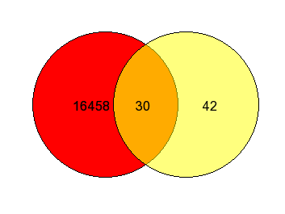
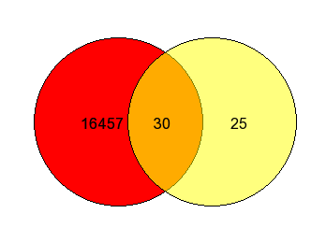
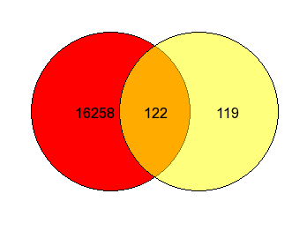
Venn diagramms of genes from the lists
in the secretome
Malignant versus benign 2. Malignant versus benign
adjacent stroma
3. Combined malignant/stroma
versus benign/stroma
Result: 154 gene signature within the secretom combined of all 3 analysis

Slide 6
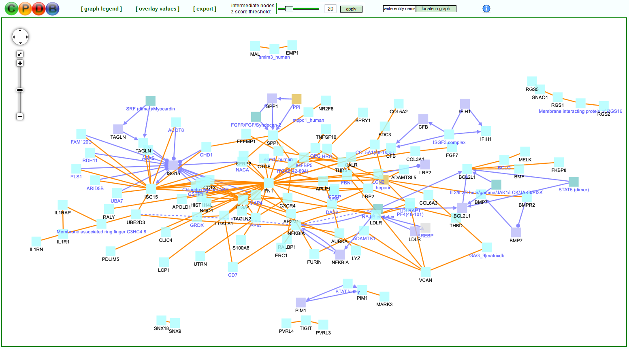

Slide 7
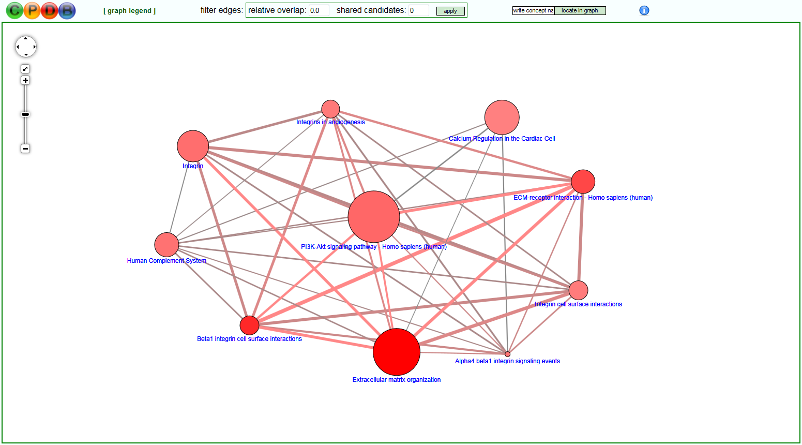

Slide 8
Validation of potential new biomarkers
1. Validation of the top 25% (n=38) plus extra 10 genes also found in the 2nd dataset (GSE14407) within the 154 gene signature by NanoString technology
In 10 serum and 10 tissue samples of
benign and malignant biopsies
A) Cluster analysis serum / tissue
B) Vulcanoblot
Validation of the top 5 genes in Serum samples and by
IHC on TMAs
A) IHC of selected, most abundant proteins on TMAs
B) ELISA of top 5 overrepresented proteins in serum

Slide 9
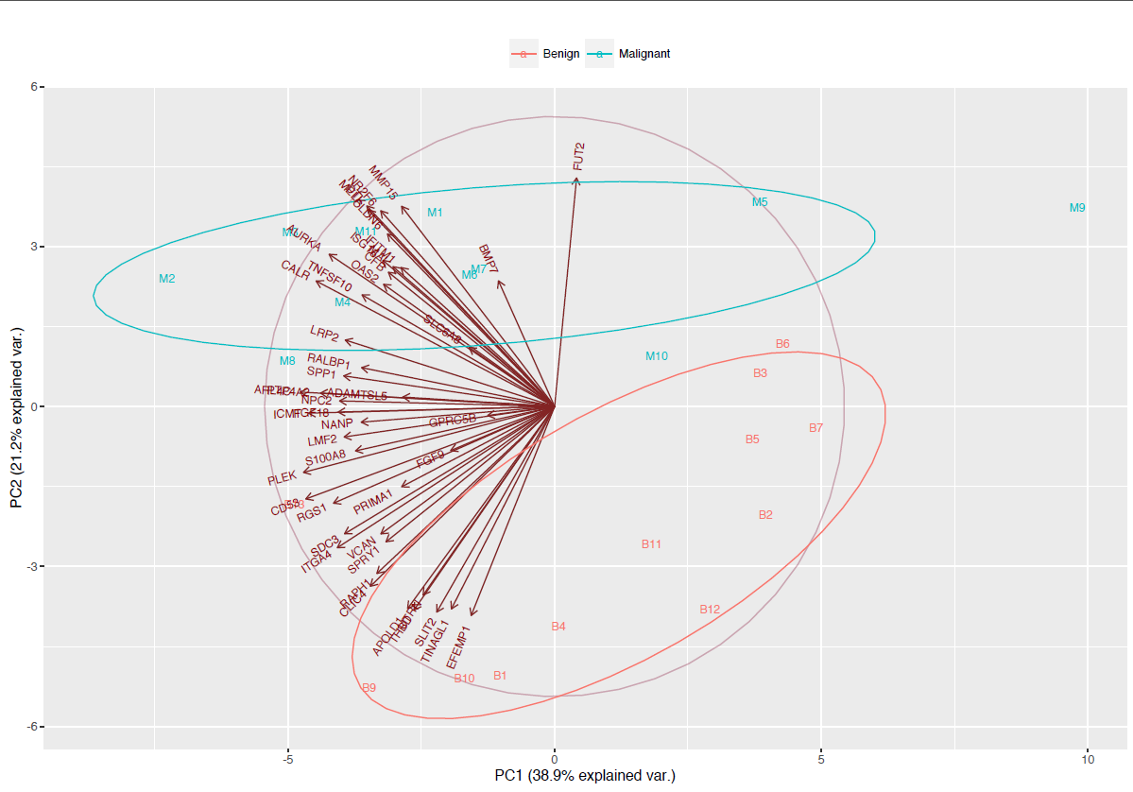
Principal component analysis (PCA) of
benign and malignant samples

Slide 10
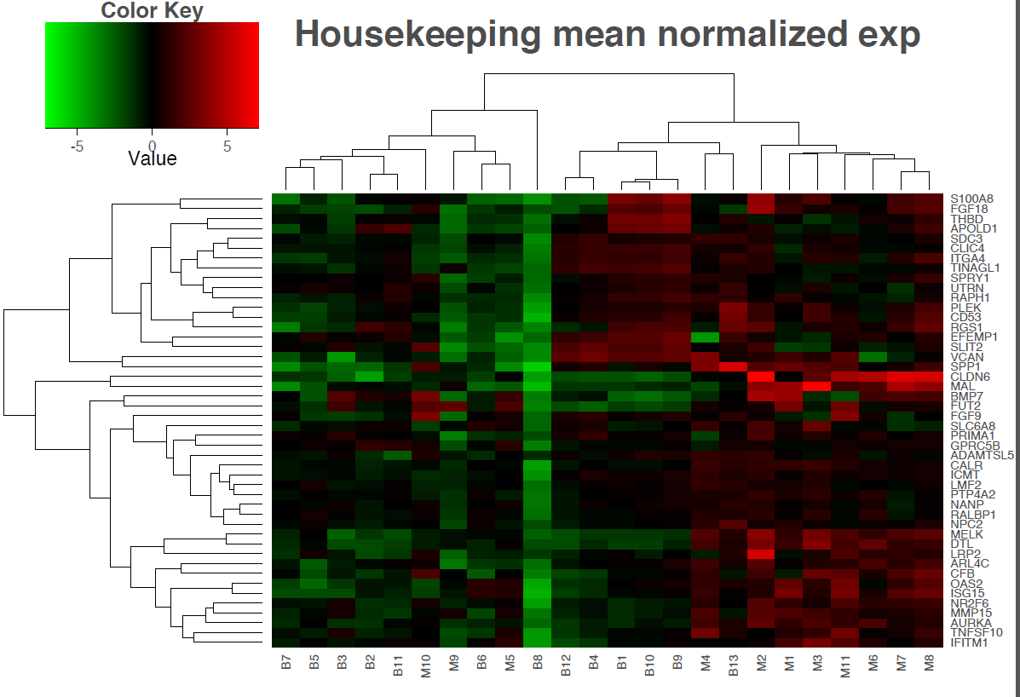
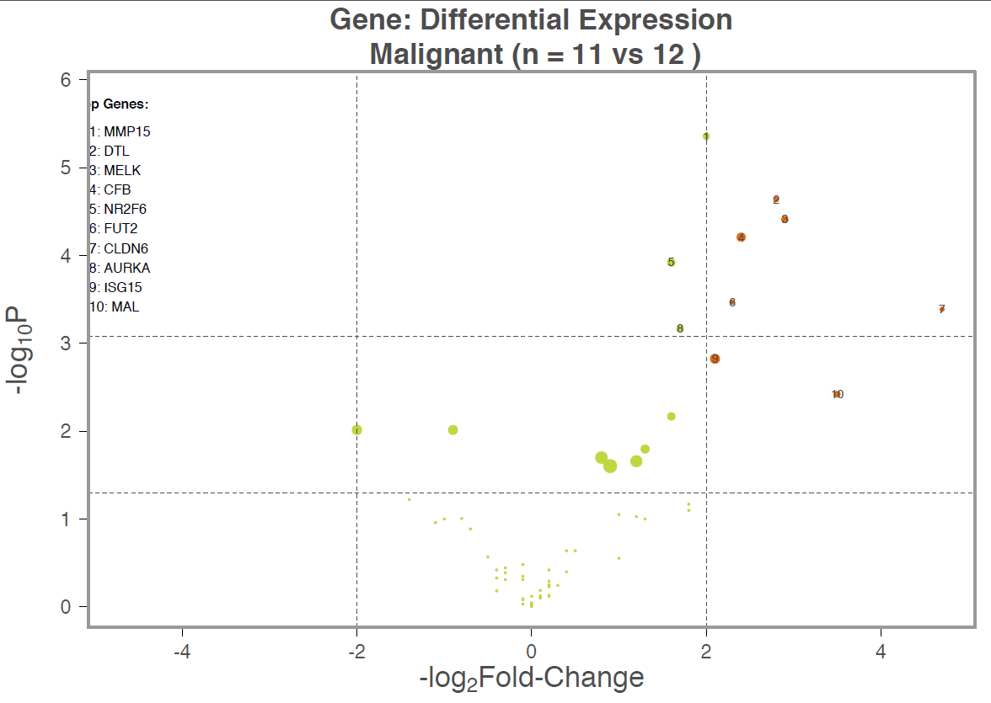
Validation of potential new biomarkers –
Nanostring technology

Slide 11
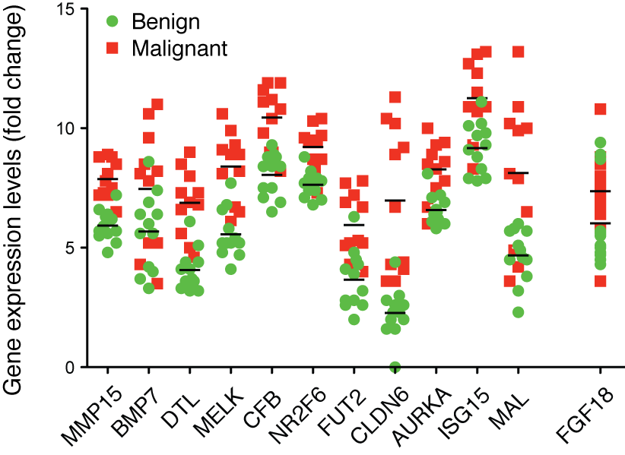
Gene expression of biomarker candidates
normalised to mean of HK genes

Slide 12

Normal distribution of protein expression

Slide 13
Gene expression of biomarker candidates
normalised to mean of HK genes
*
*
*
*

Slide 14
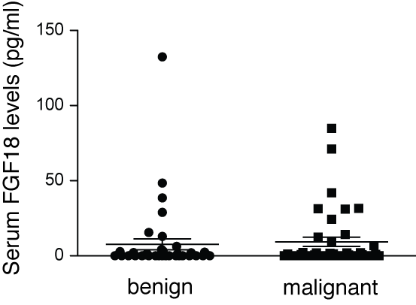
Serum levels of candidate FGF18 by ELISA

Slide 15
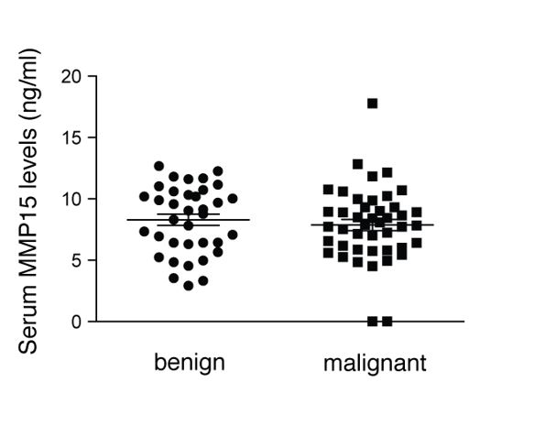
Serum levels of candidate MMP15 by ELISA

Slide 16
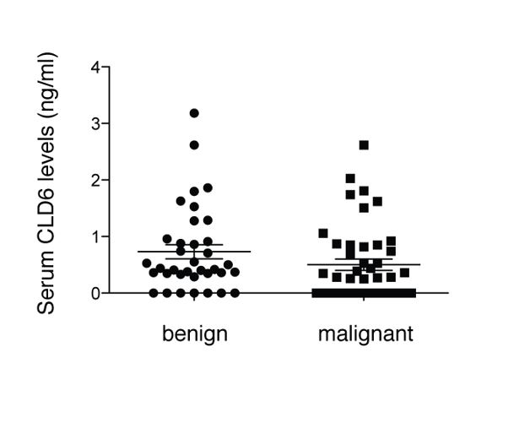
Serum levels of candidate CLD6 by ELISA

Slide 17
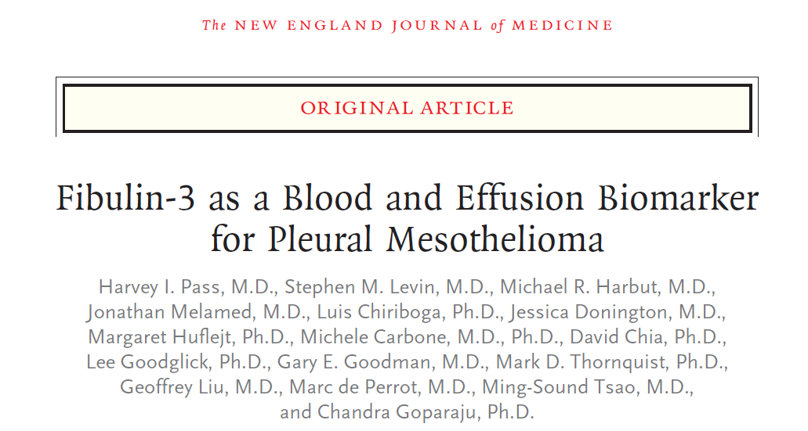

Slide 18
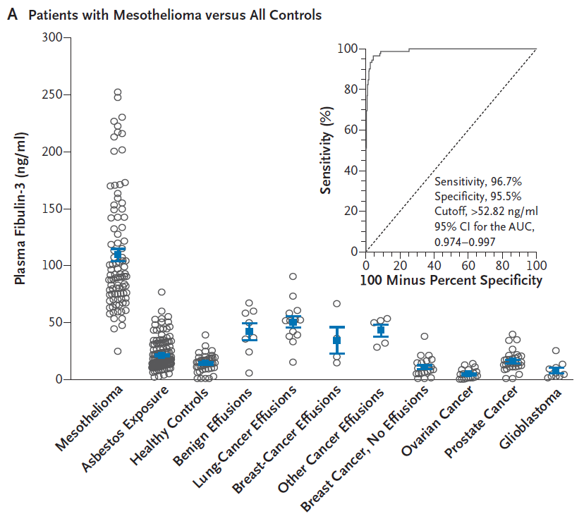

Slide 19
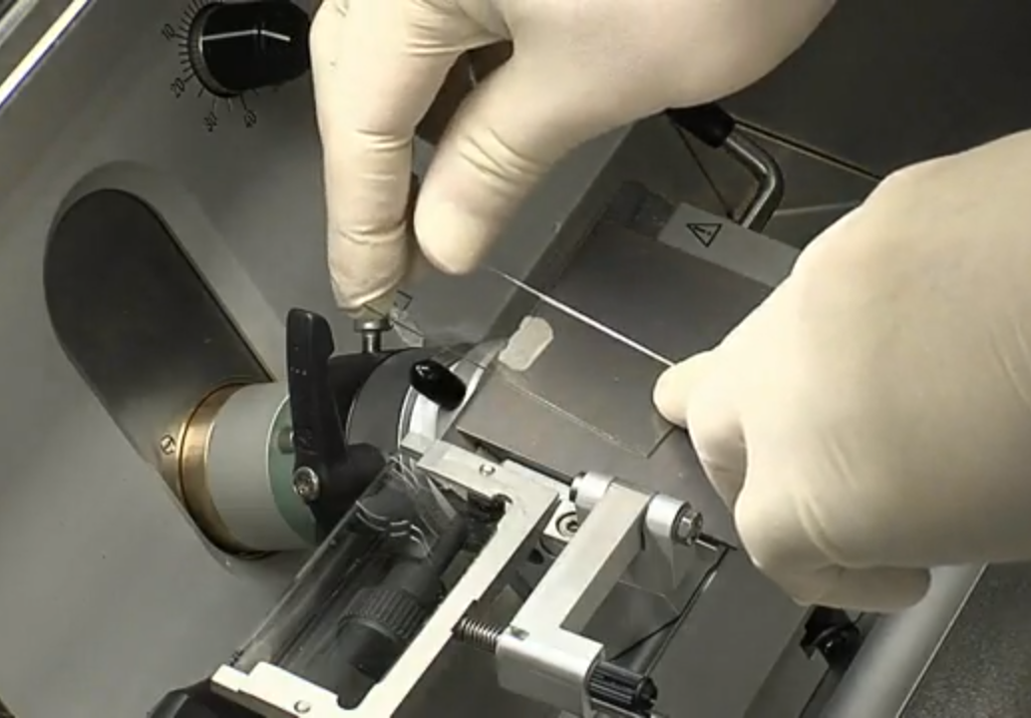
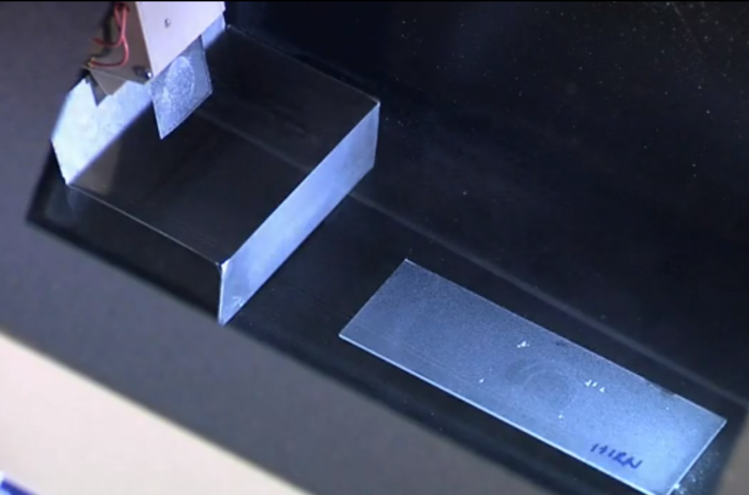
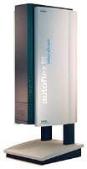
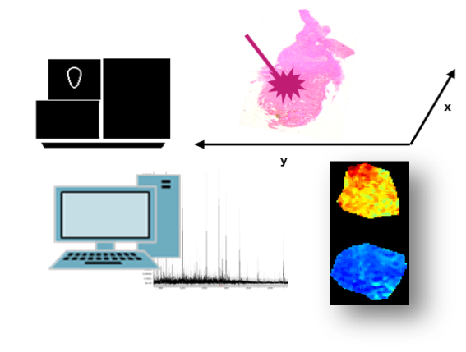
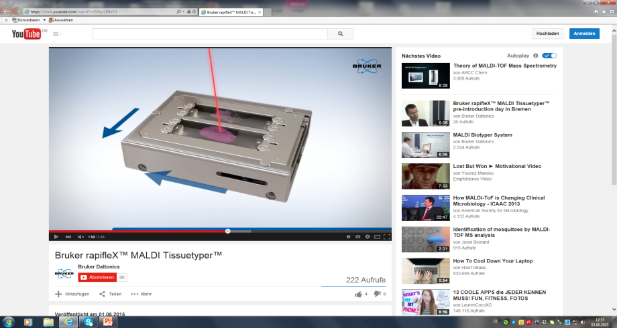
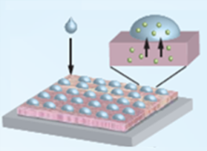

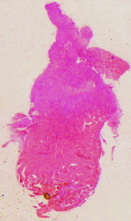
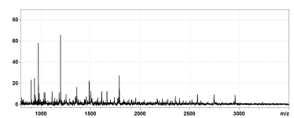
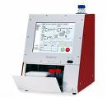

Arbeitsschema
1
2
3
Proben Präparation
Bildgebende Massenspektrometrie
Evaluierung und Visualisierung
I. Komponentenanalyse
Regionale Diskriminierung
II. Segmentierung
Regionale Analogien
80 µm
Spektren
x
y
Hypothesen Test
Regionale Diskriminierung
ROC Analyse
Regionale Diskriminierung
Peptide
Bottom Up LC-MS/MS
Reference Peptide Datenbank
mind. 2 Peptide
Notes:
Matrix : 7g/l α-Cyano-4-hydroxyzimtsäure 40mM Ammoniumbiocarbonat 1% TFA/50ACN
Formalien fixiert und Paraffin eingebettet (FFPE)
α-Cyano-4-hydroxyzimtsäure

Slide 20
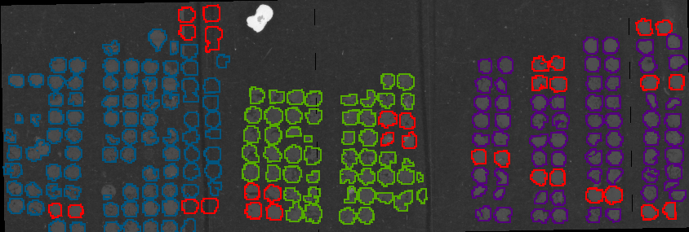
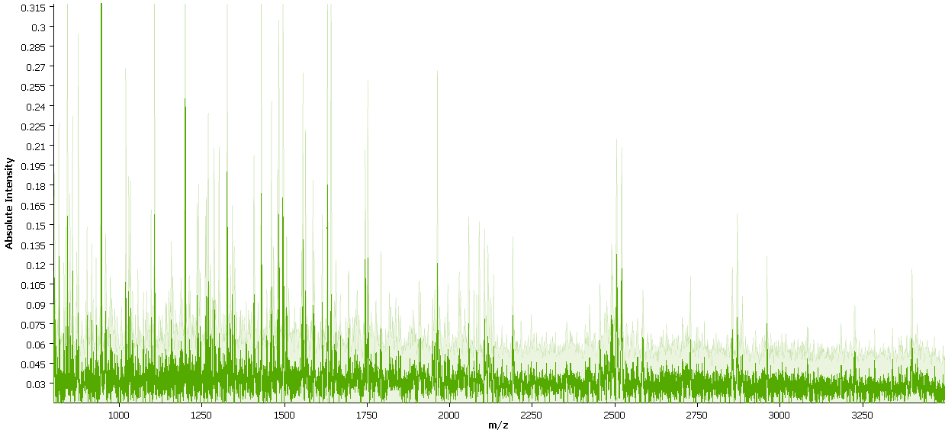
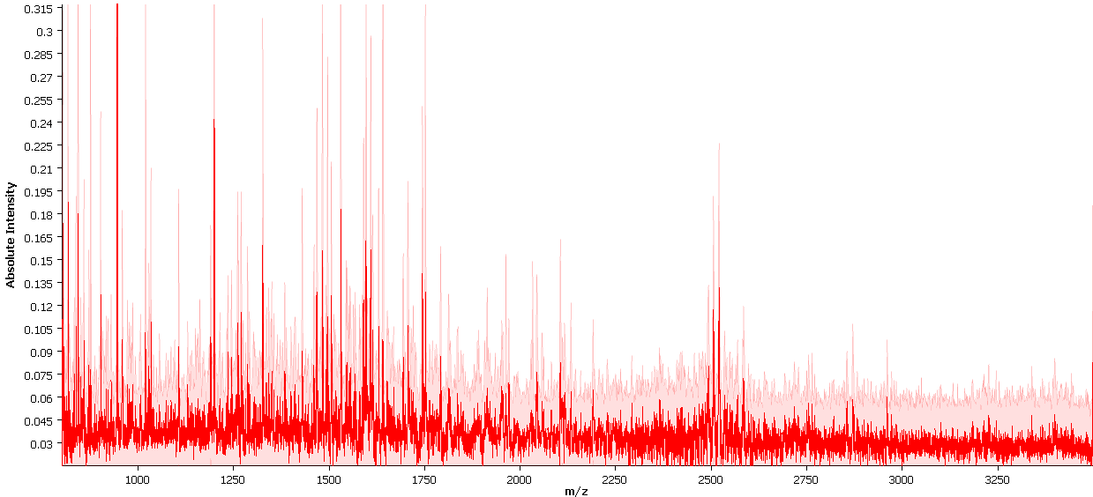
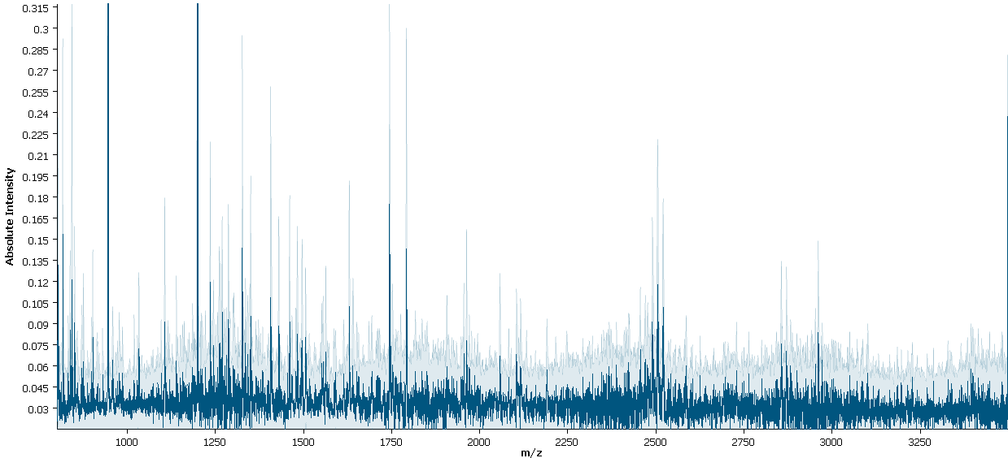
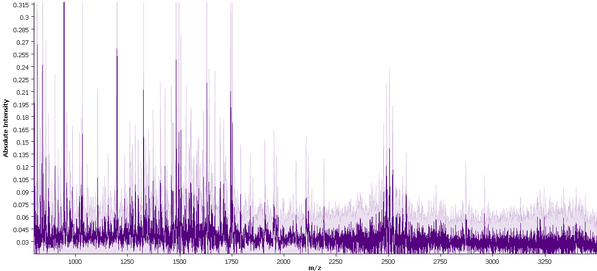
LGSC
BOT
OCC
BOT
Liver control
LGSC
OCC

Slide 21
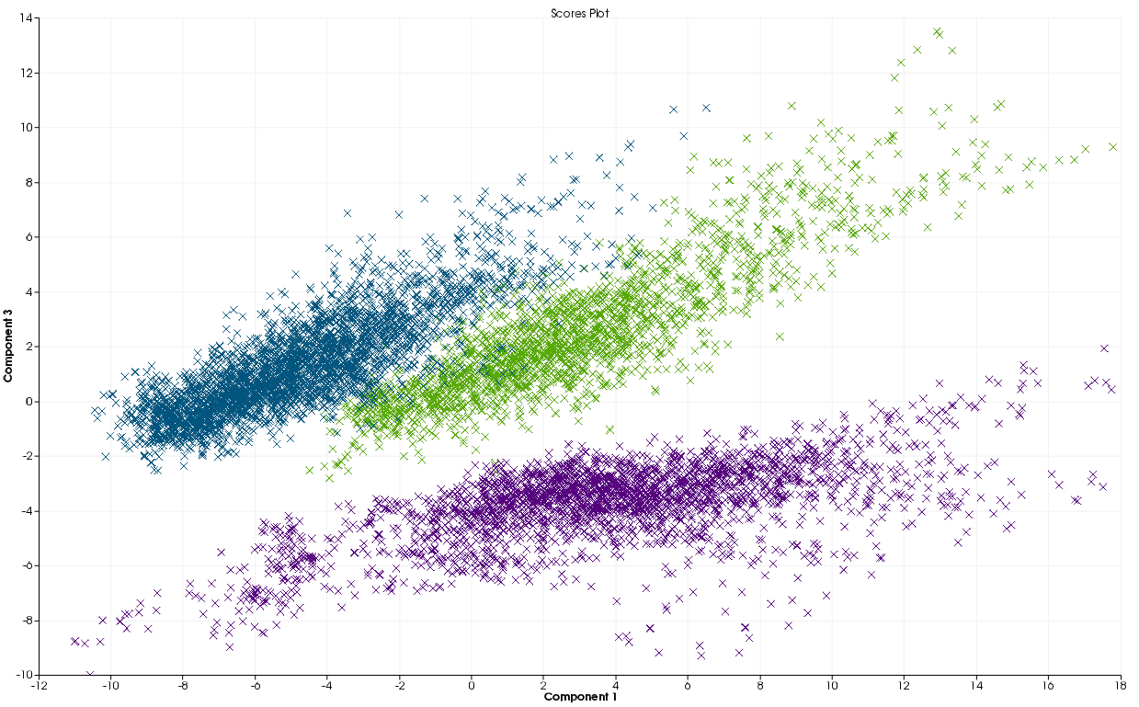
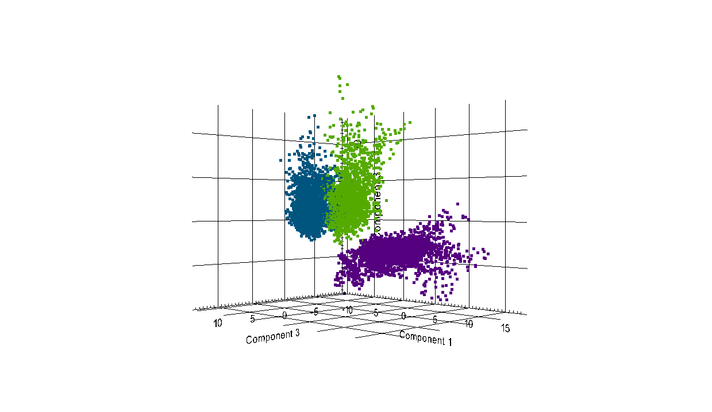
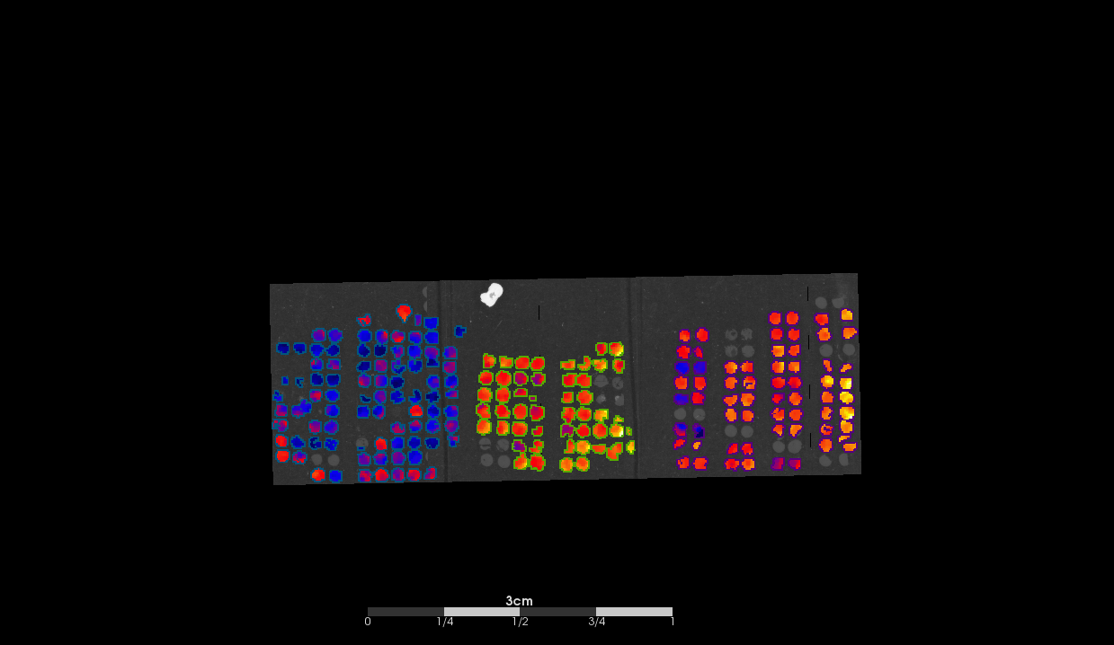
Principal Component analysis
2D Score Plot C1+C3
3D Score Plot C1+C3
BOT
LGS
OCC
Notes:
Discrimination of Spectra by PCA + Visualization of C1

Slide 22
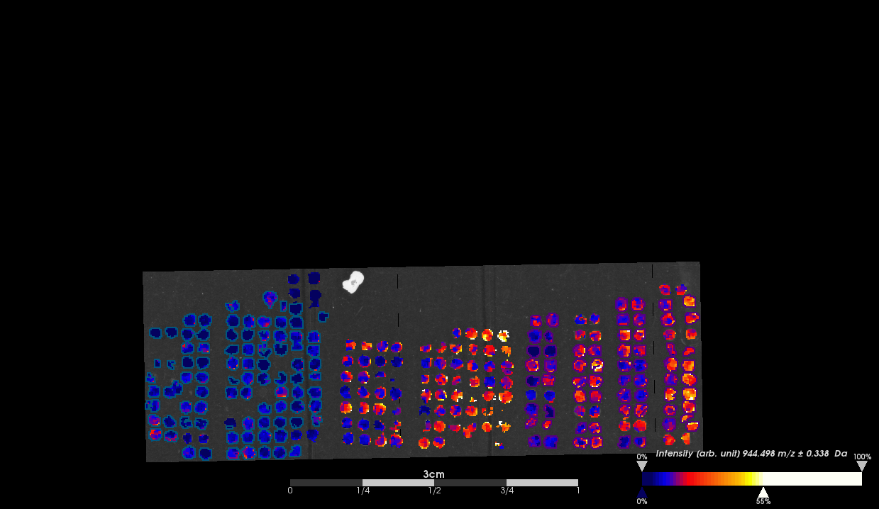
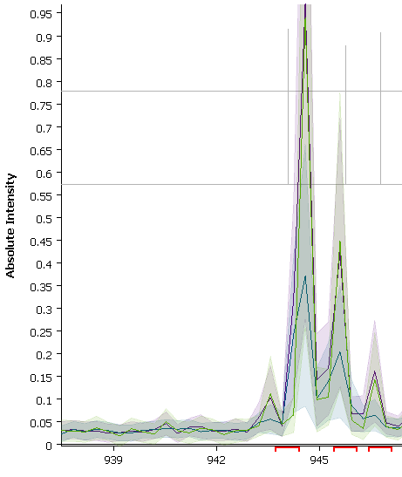

Histone H2A type 2-A m/z 944
LGSC
BOT
OCC
BOT
OCC
AUC 0.811 p<0.01
AUC 0.795 p<0.01
LGSC

Slide 23
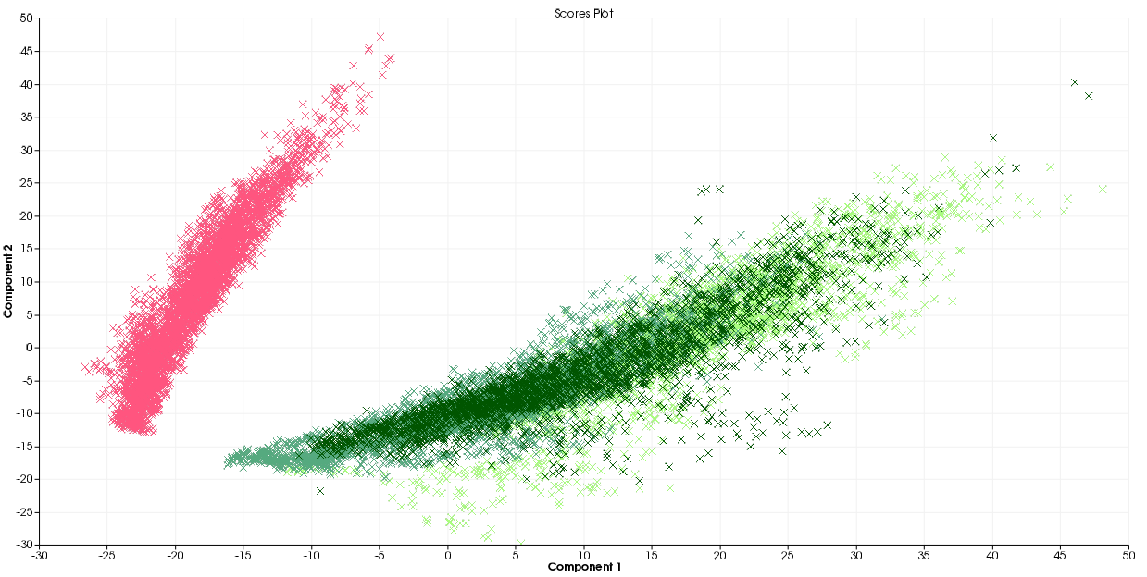
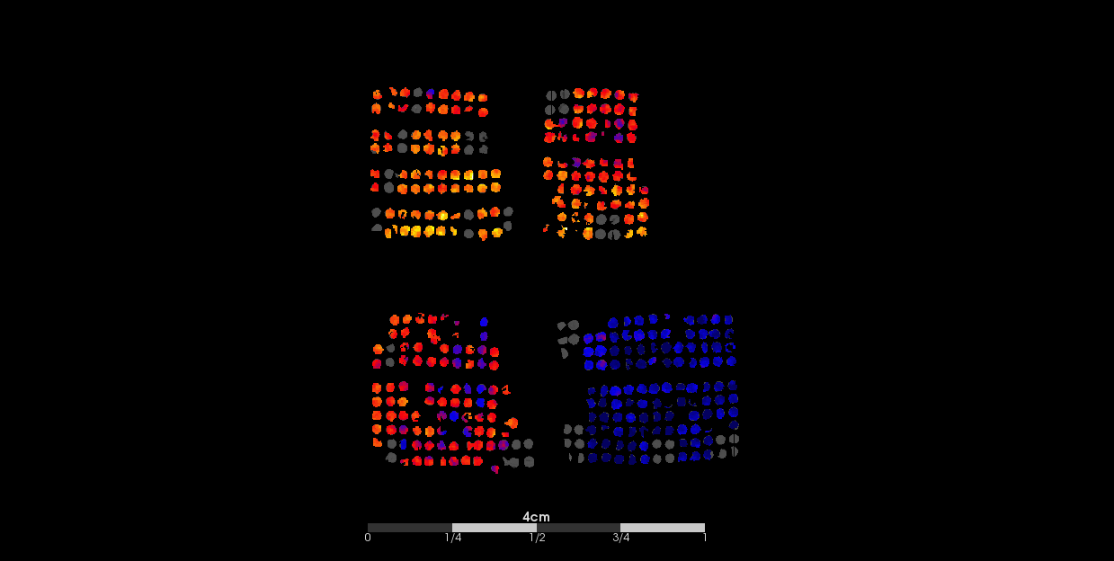
HGSC
BOT
LGSC
OCC
BOT
LGSC
HGSC
OCC

Slide 24
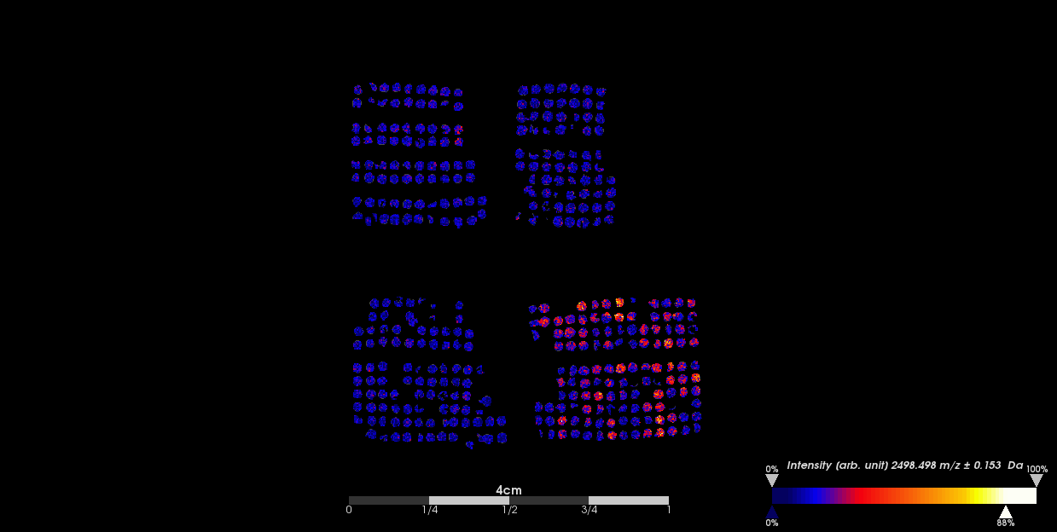
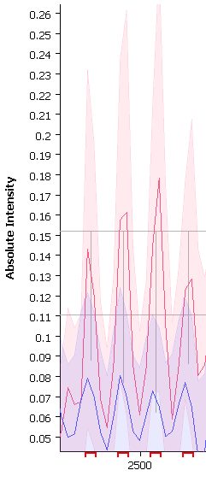
Vimentin m/z 2498
HGSC
HGSC
BOT
OCC
LGSC
Other

Slide 25
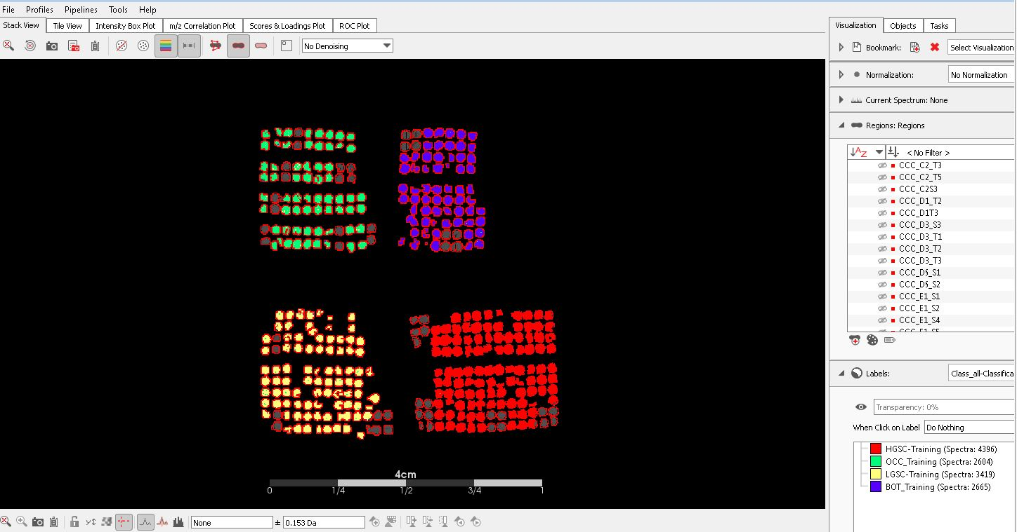
Validation of classifier profiles

